Slide 1

AZURE APP SERVICES

Slide 2

INTRODUCTION
Azure App Service is a platform-as-a-service offering Microsoft Azure that allows developers to build, deploy, and manage web applications and APIs.
It provides a fully managed platform for running web apps and mobile backends, with support for multiple programming languages such as .NET, Java, Node.js, Python and Ruby.
App Service can scale up or out manually or automatically.

Slide 3
WHY USE APP SERVICES
Multiple Frameworks and Languages
Automatic Updates
Security and Compliance
Application Templates

Slide 4
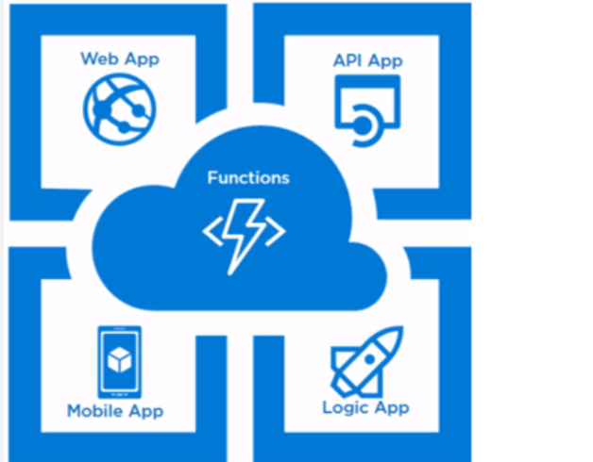
TYPES OF APP SERVICES
Web Apps
API App
Logic App
Mobile App

Slide 5
WEB APPS
It allows us to deploy our web application without having to worry about the necessary infrastructure.
The Azure Web App Service removes all of these stumbling blocks.
some of the features of the Web app service:
Support for auto-scaling based on load is built-in.

Slide 6
API APP
It aids in the deployment of Web APIs. ASP.net Web API or the equivalent in other languages can be used to design and deploy APIs.
You can use this API both internally and externally (for example, through an API request from Logic Apps).
To secure the APIs, it provides identification. It includes a swagger implementation that allows us to test APIs.

Slide 7
LOGIC APP
Azure Logic Apps, from Microsoft Azure , is a cloud-based Platform-as-a-Service (PaaS) that is used to automate tasks, workflows, etc.
It helps in creating and designing automated workflows that are capable of integrating services, systems, and applications.
Azure Logic Apps is used in a majority of organizations and B2B scenarios for developing highly scalable integration solutions.

Slide 8
MOBILE APP
It helps us to construct mobile application backends.
Modern mobile apps may run on Android, iOS, or UWP, and in the background, the app will request any type of transaction from the back-end.
It is similar to online services that support a mobile client. This service offers nearly all of the features that Web Apps do.

Slide 9
BENEFITS
Multiple Languages and Framework
Manages Production Environment
High Availability on a Global Scale
Compliance and Security
Restrict Access
Application Templates

Slide 10

APP SERVICE PRICING
The Azure App Service combines everything we need to build websites, web APIs, and mobile backends for any platform or device.
It offers a pocket-friendly charge and lets us select any plan that meets our needs and requirements.
The free and shared plans allow us to test our app without breaking the bank. There is also a specialized Virtual Machine plan. You may find three sub-categories, Basic, Standard, and Premium.
Our application is hosted in a private, dedicated Azure environment with an isolated plan.

Slide 11

Presented by
Sonia Netinti

